Slide 1
Object Oriented Frameworks (in Work)
Prof. Dr. Dirk Riehle
Friedrich-Alexander University Erlangen-Nürnberg
ADAP C12
Notes:
It is Friedrich-Alexander University Erlangen-Nürnberg – FAU, in short.
Corporate identity wants us to say “Friedrich-Alexander University”.

Slide 2
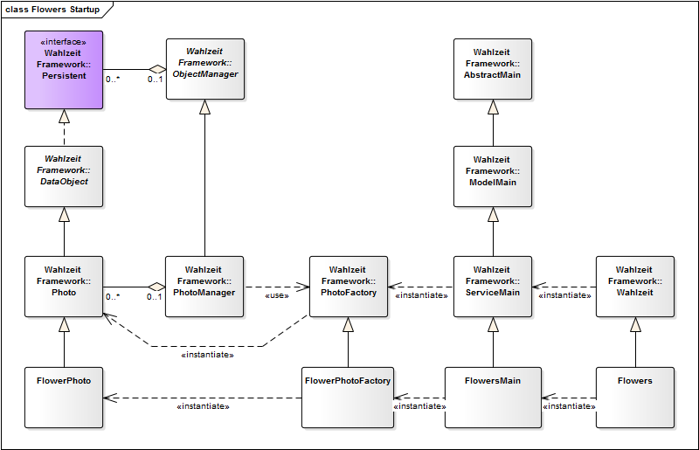
Wahlzeit Start-up

Slide 3
Topics
Definition
Interfaces
Packaging
Layering

Slide 4
Object-Oriented Framework
Definition of object-oriented framework
  Is an abstract object-oriented design that can be reused
  Has default implementation classes that can be used
  Typically covers one particular technical domain
White-box framework
  An object-oriented framework mostly used by implementing subclasses
  Requires user to understand internal workings of framework
  Typically form of a framework in its early stages
Black-box framework
  An object-oriented framework mostly used by composing instances
  Easier to use by less flexible than white-box framework
  Typically form of a framework in its mature stages

Slide 5
Frameworks vs. Libraries (Toolkits)
Frameworks
  Reuse of abstract design
    Inheritance and delegation
      Inheritance interface
    High cohesion of classes
    More difficult to use than library
  Examples
    Java Object framework
    Wahlzeit domain model
Libraries
  No reuse of abstract design
    No or little use of inheritance
      Only use-relationship
    Loose class relationships
    Easier to use than framework
  Examples
    Java utility classes
    Wahlzeit utility classes

Slide 6
Framework Interfaces
Use-client interface
Inheritance interface
Meta-object Protocol

Slide 7
Use-Client Interface
The use-client interface is the traditional interface
  Invoked using method calls by client objects on framework objects
Best practices of defining use-client interfaces
  An abstract object-oriented design that reflects the domain
    Using interfaces, abstract classes, and implementation classes
    Using collaborations spelling out roles and their responsibilities
    Using exceptions properly to document behavior in case of failure
  With clear idea of types of objects, for example, value objects
  With clear idea of patterns employed to structure the design

Slide 8
Inheritance Interface
The inheritance interface uses polymorphism
  Subclasses extend the design while conforming to it
  Leads to inverted control-flow, a.k.a. “Hollywood principle”
Best practices of defining inheritance interfaces
  An abstract object-oriented design that reflects the domain
    Using the abstract superclass rule
    Using the narrow inheritance interface principle
  With clear idea of patterns employed to structure the interface, e.g.
    Primitive and composed methods
    Factory method, template, method, etc.
  Document extension points

Slide 9
Meta-object Protocol (Java Annotations)

Slide 10
Framework Packaging
Frameworks have a design but are code components
Package a framework as a code component
  Group by object collaborations, not class inheritance
  Utilize language-specific packaging mechanism
If necessary, separate functional packages
  Interface, implementation, and testing packages

Slide 11
Framework Layering
Frameworks use and extend other frameworks
  Use = utilizing use-client interfaces
  Extend = utilizing inheritance interfaces
Use needs to be prepared for, foreseen by designers
  Utilizing the two general types of interfaces
  Using specific mechanisms like role objects
Code layers in an application reflect framework layers

Slide 12
Thanks! Questions?
dirk.riehle@fau.de – http://osr.cs.fau.de
dirk@riehle.org – http://dirkriehle.com – @dirkriehle
DR

Slide 13
Credits and License
Original version
  © 2012-2016 Dirk Riehle, all rights reserved
Contributions
  ...

